Slide 1
The Future of Microservice
wongoo,2021/12/14

Slide 2
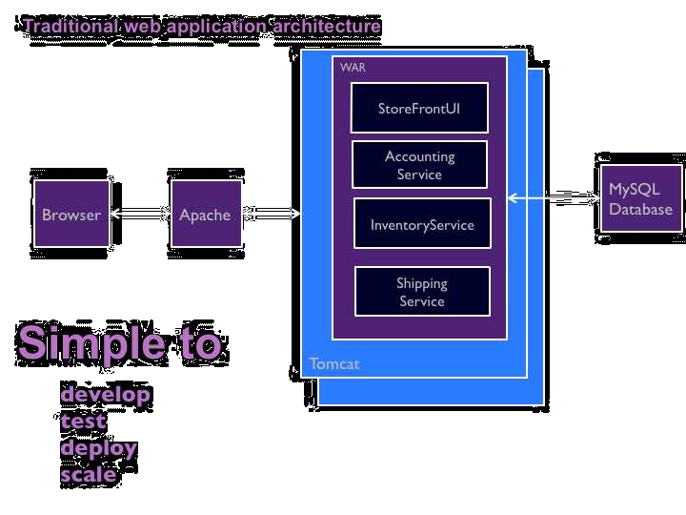
Monolithic
https://microservices.io/patterns/monolithic.html

Slide 3
Monolithic Success When
small business , small team
simple, easy to understand and modify
new developer quickly become productive
https://microservices.io/patterns/monolithic.html

Slide 4
Drawbacks of Monolithic
Large code base intimidates developers
Overloaded IDE
Startup slowly
Large runtime resource requirement
Continuous deployment is difficult
Scaling the application can be difficult
Obstacle to scaling development team
Long peroid of development
Technology stack limitation
https://microservices.io/patterns/monolithic.html

Slide 5
Microservice
Highly maintainable and testable
Loosely coupled
Independently deployable
Organized around business capabilities
Owned by a small team
https://microservices.io/index.html

Slide 6
Pattern of Microservice

Slide 7
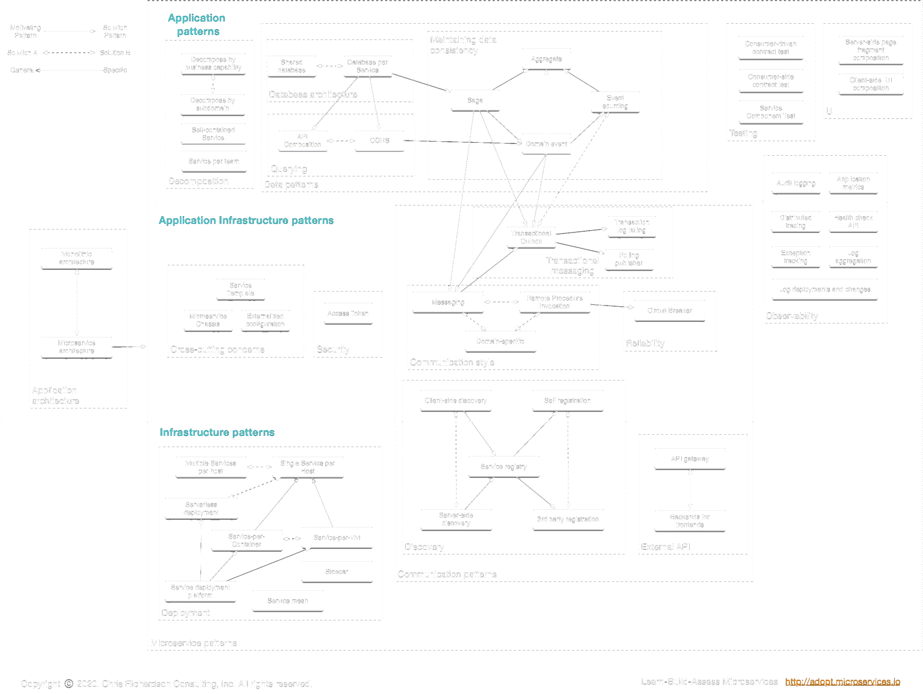

Slide 8
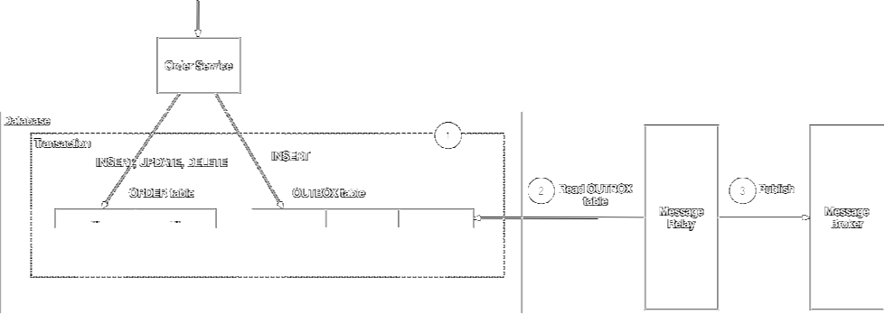
Transactional outbox
https://microservices.io/patterns/data/transactional-outbox.html

Slide 9
Implement Microservice

Slide 10
Any organization that designs a system (defined broadly) will produce a design whose structure is a copy of the organization's communication structure.
-- Melvin Conway, 1968

Slide 11
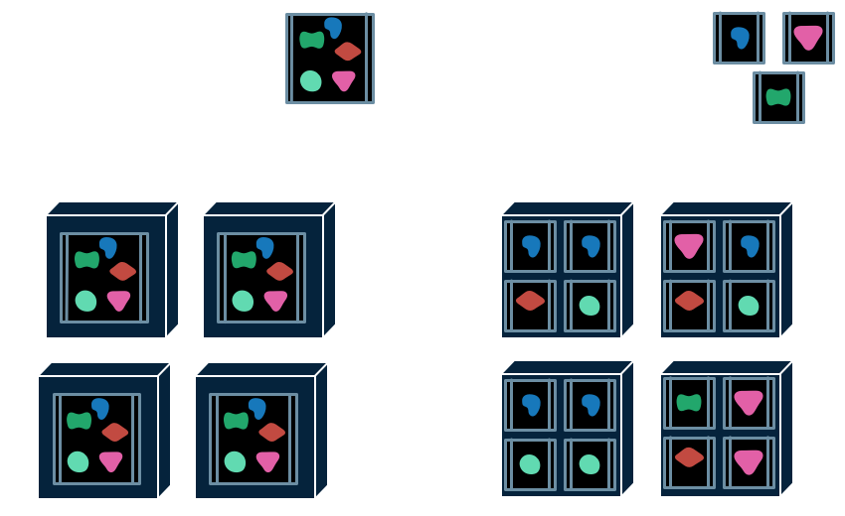
Monolithic to Microservice
https://martinfowler.com/articles/microservices.html

Slide 12
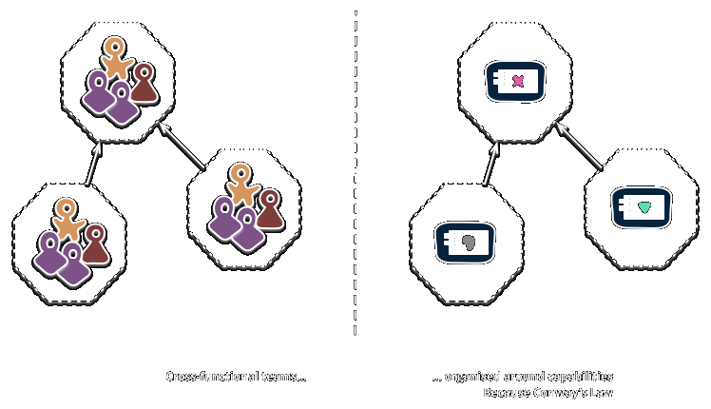
https://martinfowler.com/articles/microservices.html

Slide 13
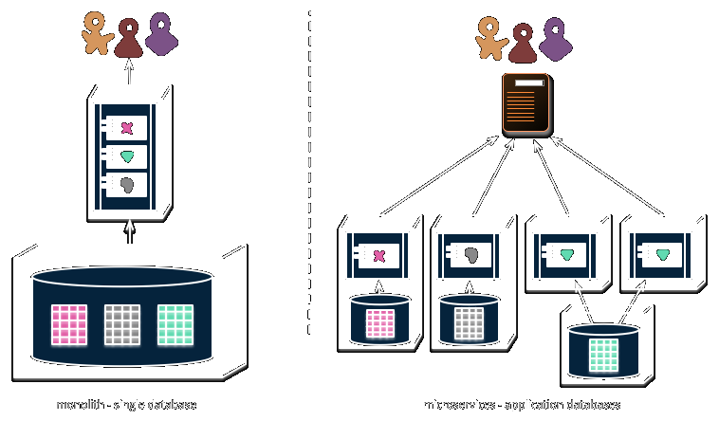
https://martinfowler.com/articles/microservices.html

Slide 14
Microservice Practice
services&teams decomposed by business
dubbo/zookeeper/apollo
mysql/postgresql/mongodb/redis/polardb/hbase
rocketmq/kafka
pinpoint/skywalking
elasticsearch/kibana
prometheus/grafana
api gateway/backend
kubernetes
gitlab/jenkins/deploy platform

Slide 15
Drawbacks of “Tranditional” Microservice
Lots of technology stack
New developer is hard to become productive quickly
Benefit conflict between “corss-cutting concerns team” vs “business team”, while business logic based on microservice framework
Cross-cutting concerns logic change needs to update all existing services individually

Slide 16
Service Mesh
A configurable, low‑latency infrastructure layer
Handle network‑based interprocess communication
Provides critical capabilities including service discovery, load balancing, encryption, observability, traceability, authentication and authorization, and support for the circuit breaker pattern.
A sidecar for each service instance
Upgrade individually, operations teams for sidecar, business teams for business service
https://nginx.com/blog/what-is-a-service-mesh/

Slide 17
Microservice to Service Mesh
Service
Service
＋
Sidecar
buisness logic
buisness logic
service discovery
SDK
Lite SDK
load balance
protocol codec
protocol codec
circut break
service discovery
observability
load balance
traceability
circut break
...
observability
traceability
...

Slide 18
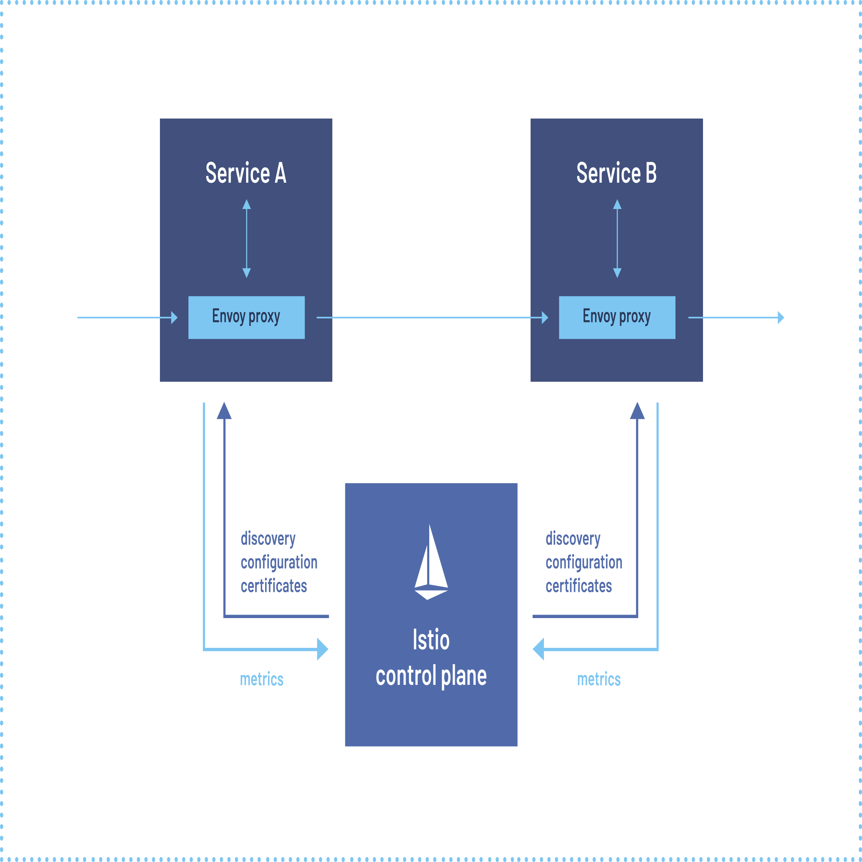
Istio Service Mesh
https://istio.io/latest/about/service-mesh/

Slide 19
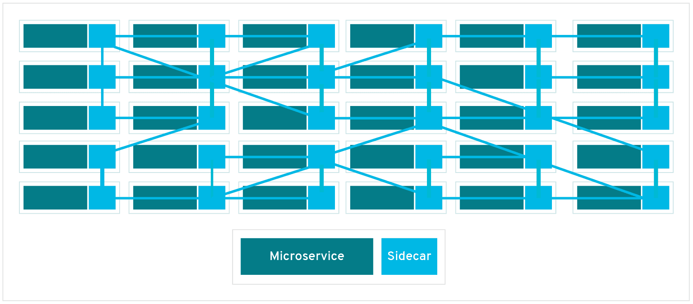
Service Mesh Sight

Slide 20
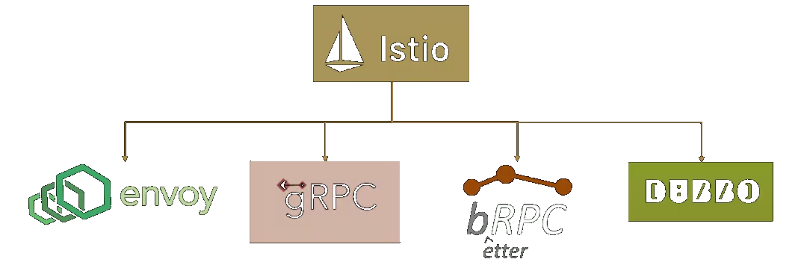
More data-panel options

Slide 21
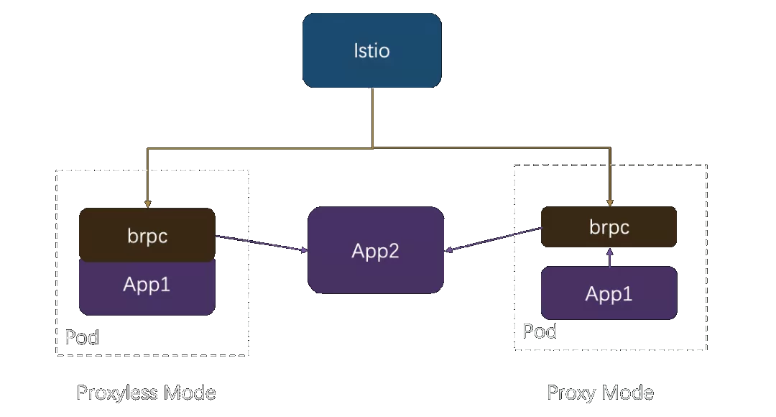
Proxy vs Proxyless
https://mp.weixin.qq.com/s/G8vmlJyaimux_K-548kFbA

Slide 22
Proxyless Mesh vs Tranditional-Microservice
Mesh is an capabilities standard, managed by control panel
Proxyless is prefer a deployment composite mode
Tranditional-Microservice build on capabilities framework

Slide 23
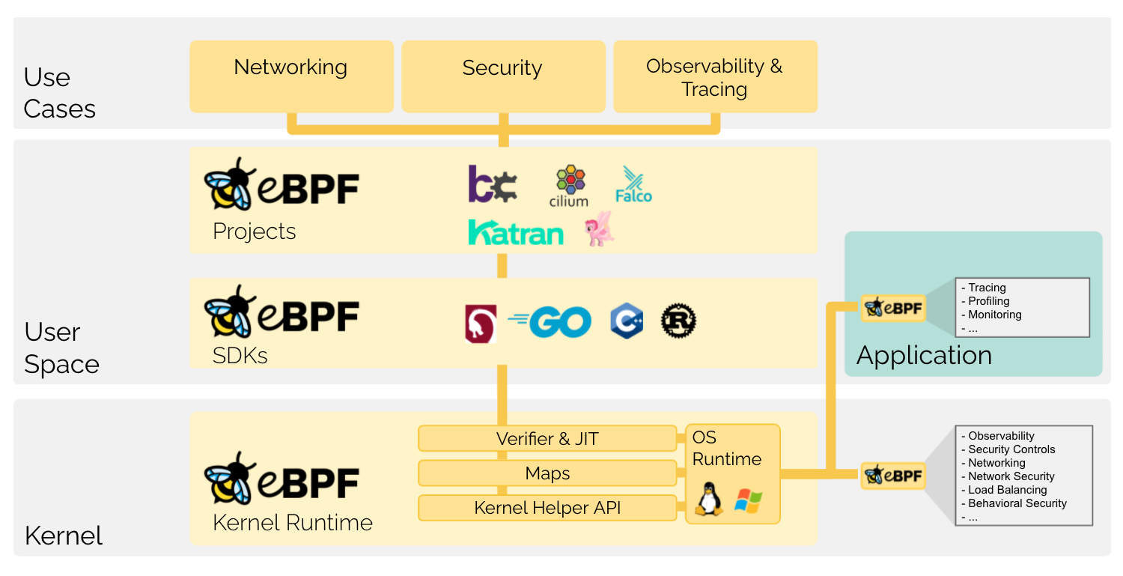
eBPF
https://ebpf.io/

Slide 24
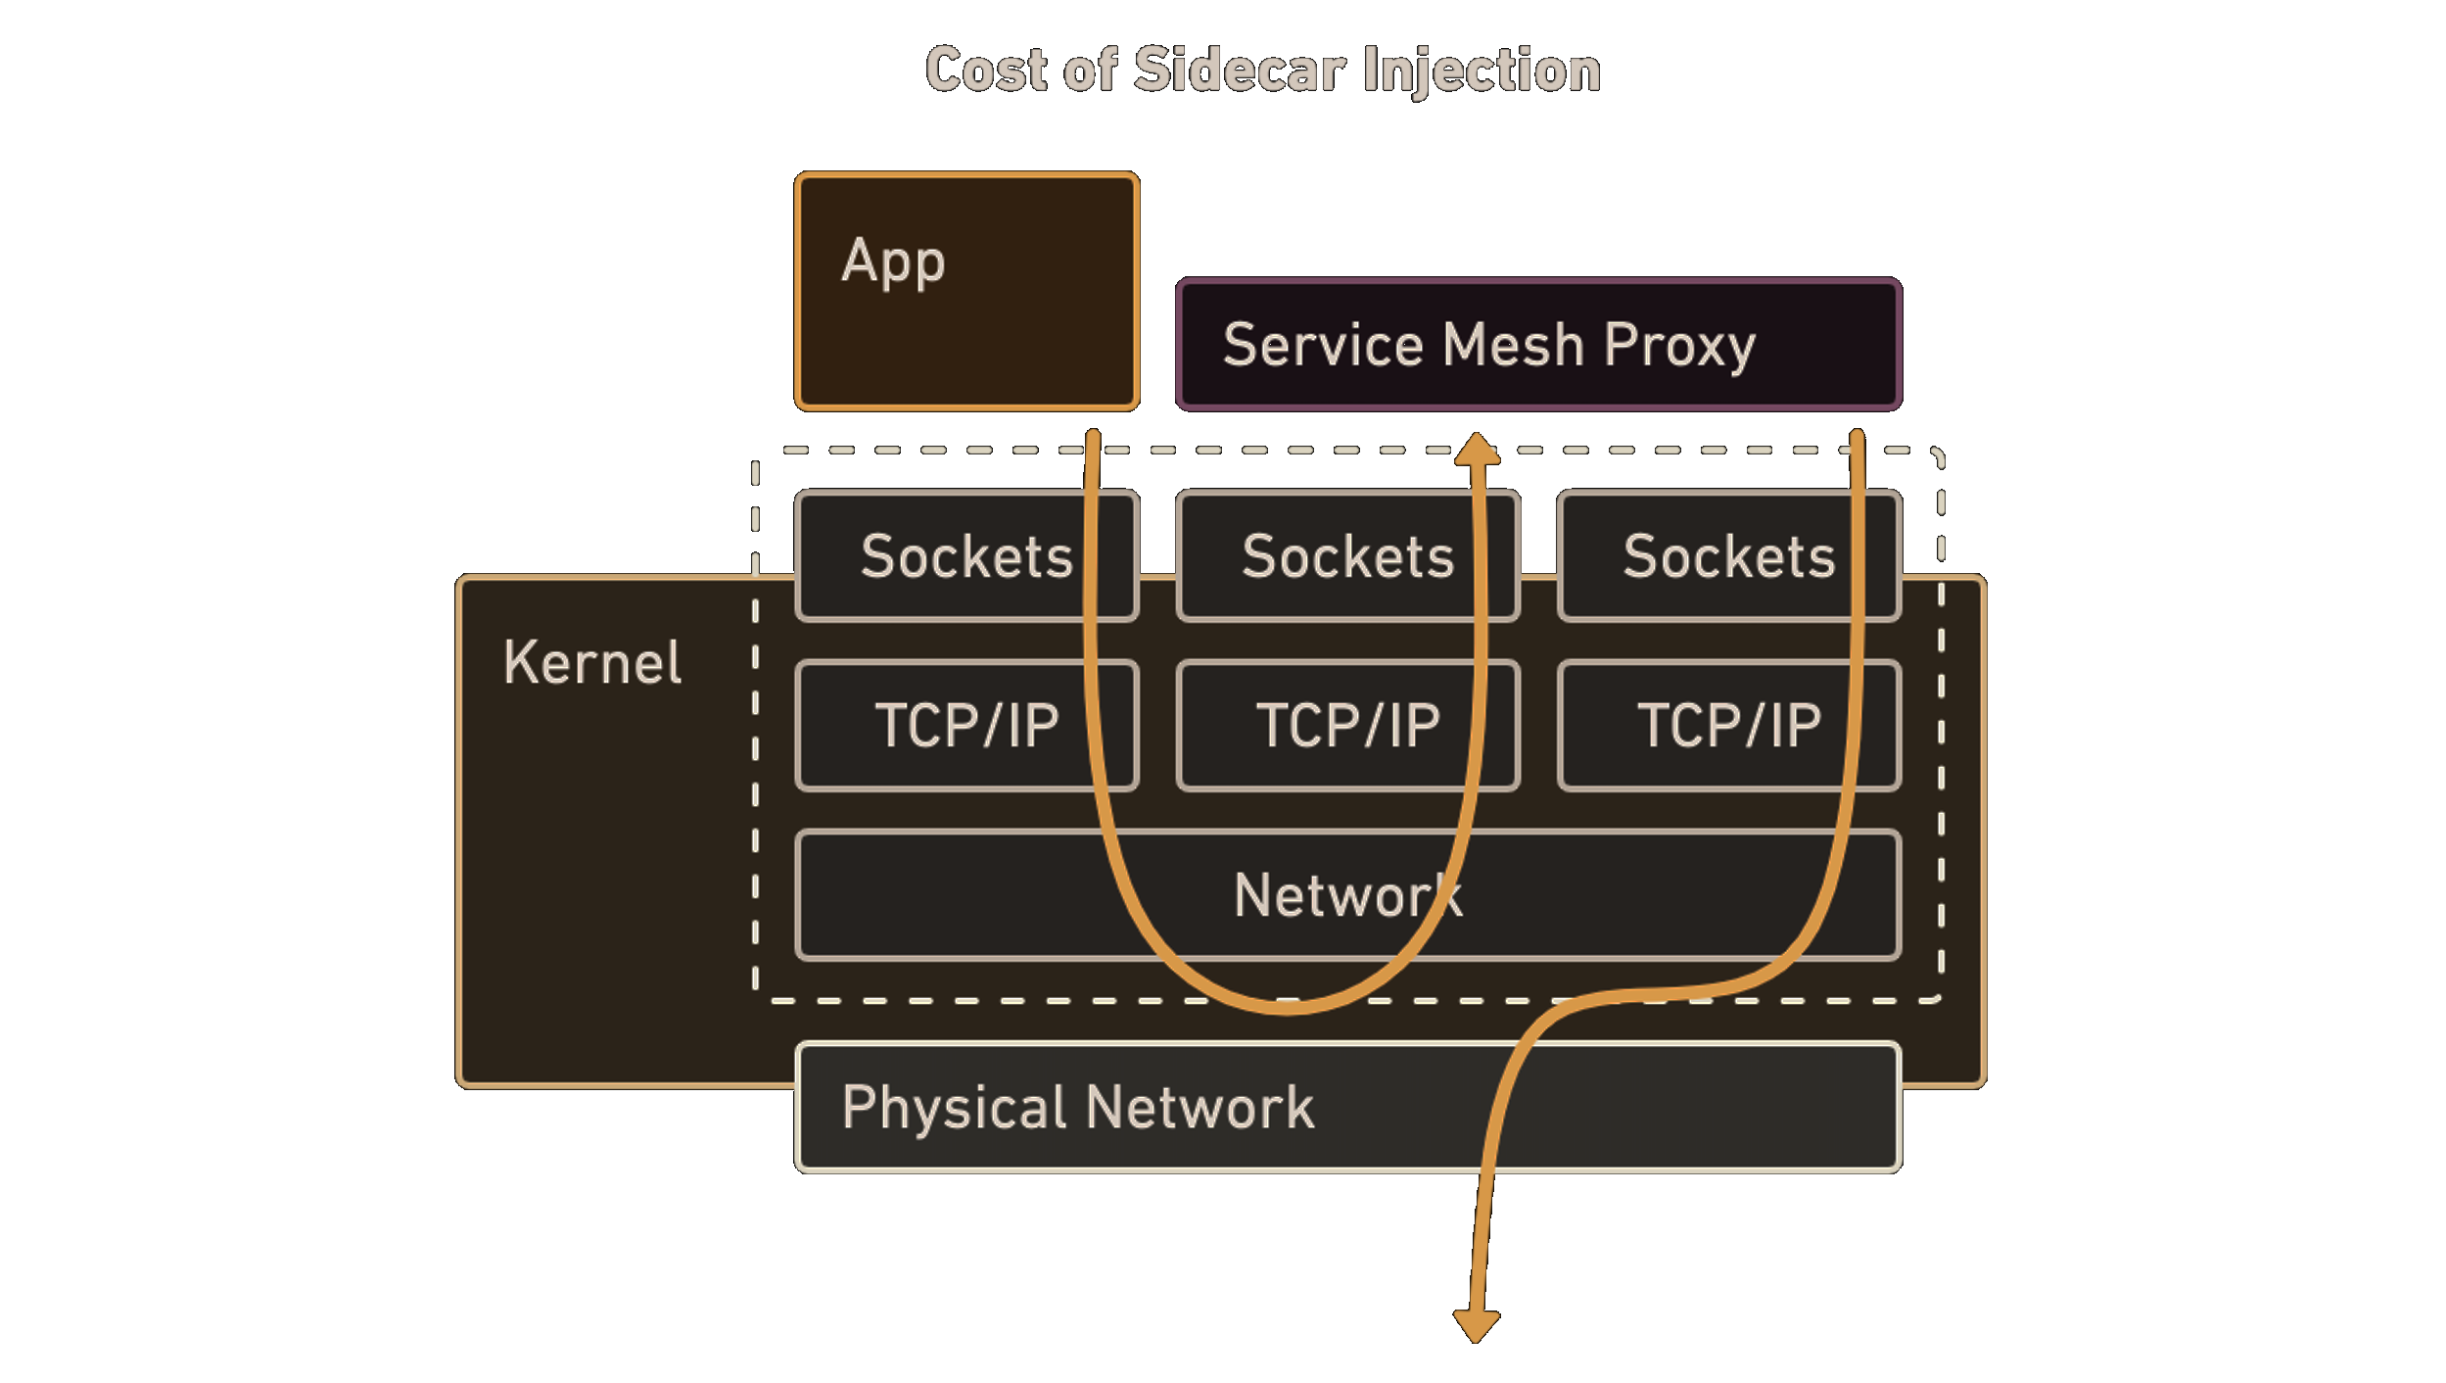
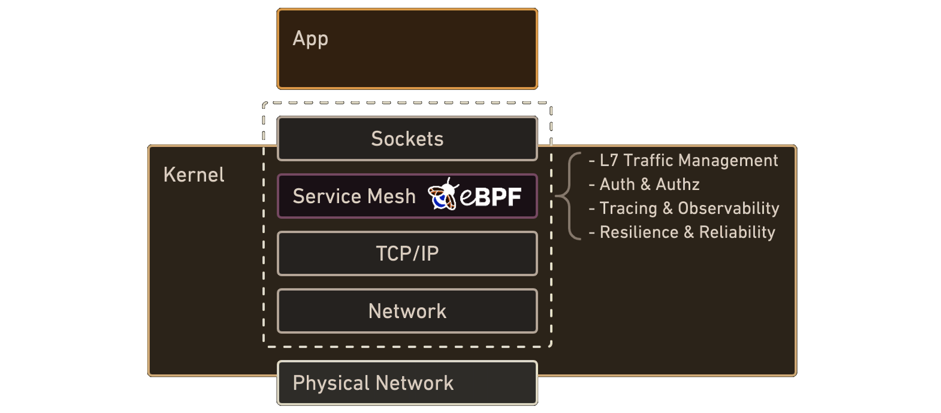
eBPF Service Mesh
https://isovalent.com/blog/post/2021-12-08-ebpf-servicemesh

Slide 25
Drawbacks of Service Mesh
Programing on middleware, lots of middleware sdk, diffcult to upgrade or change
New developer is not easy to become productive quickly
Coupling between business and infrastructure is still exists

Slide 26
Application-runtime Microservice
Standard API on lifecycle,stata,network,binding for business develop
A mecha for one/more service instances
A mecha is a sidecar with generic api capabilities
Crosss language SDK
Business user not care runtime components (operations cares)

Slide 27
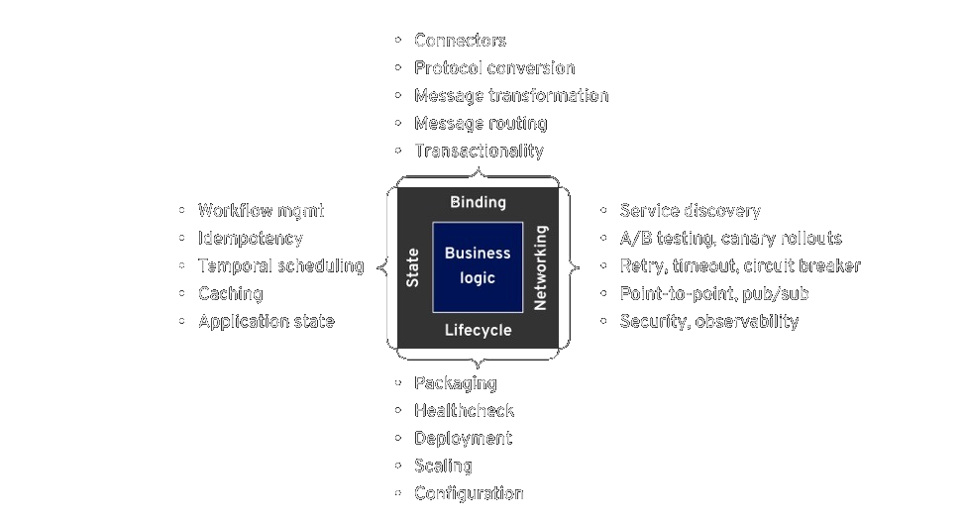
Application-runtime capabilities

Slide 28
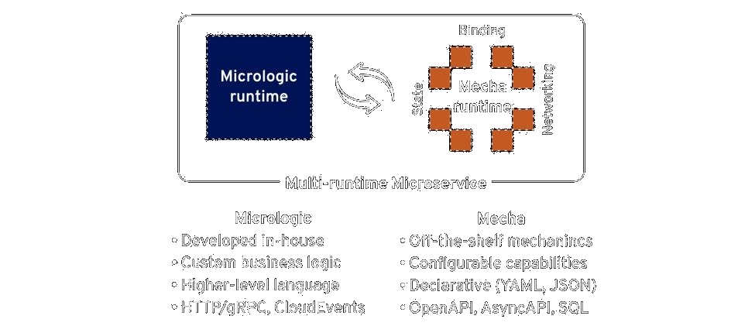
Application-runtime Microservice

Slide 29
Microservice to Application-runtime
Service
Service
Mecha
buisness logic
buisness logic
Generic Ability
＋
binding
middleware sdk
App Runtime SDK
state
protocol codec
networking
SDK
standard api
lifecycle
protocol codec
service discovery
Basic Ability
load balance
service discovery
circut break
load balance
observability
circut break
traceability
observability
...
traceability
...

Slide 30
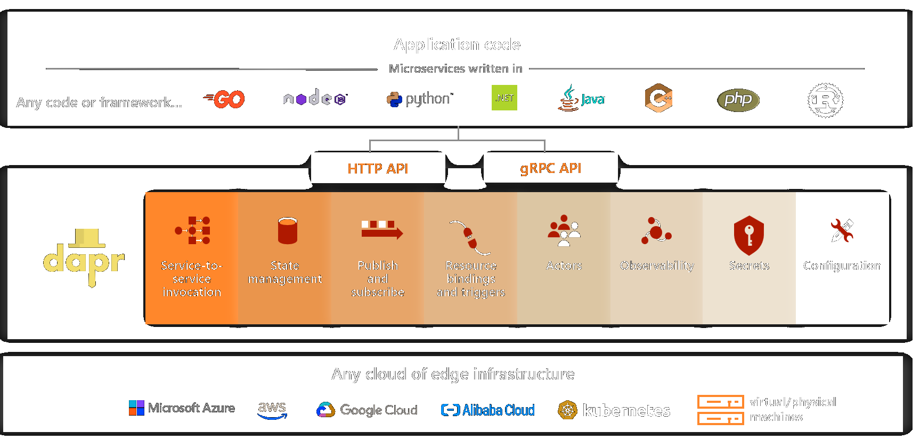
Dapr (Distributed Application Runtime)
https://docs.dapr.io/concepts/overview/

Slide 31
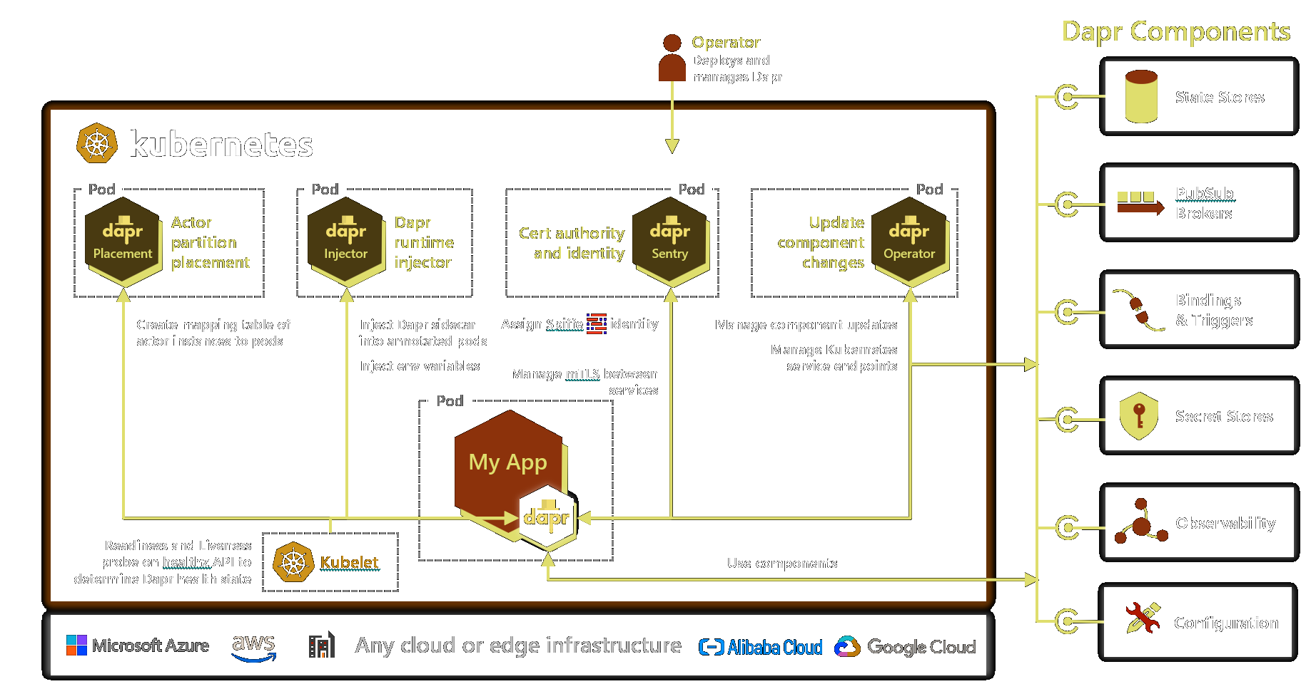
Dapr on Kubernetes Overview
https://docs.dapr.io/concepts/overview/

Slide 32
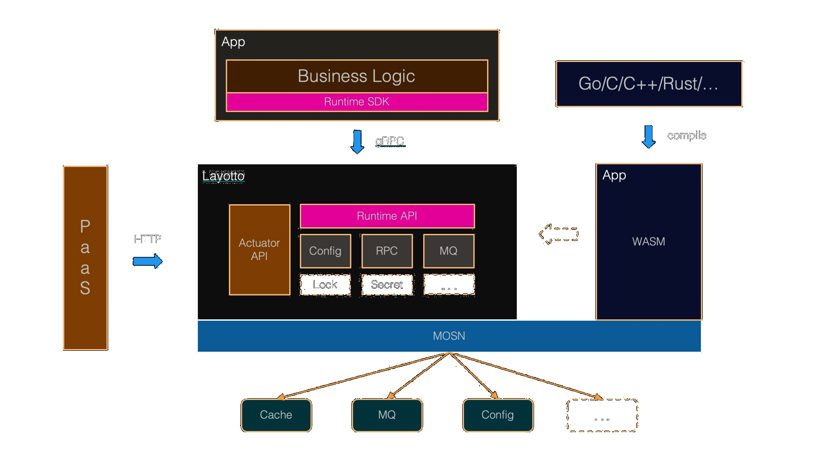
Alibaba Layotto
https://github.com/mosn/layotto

Slide 33
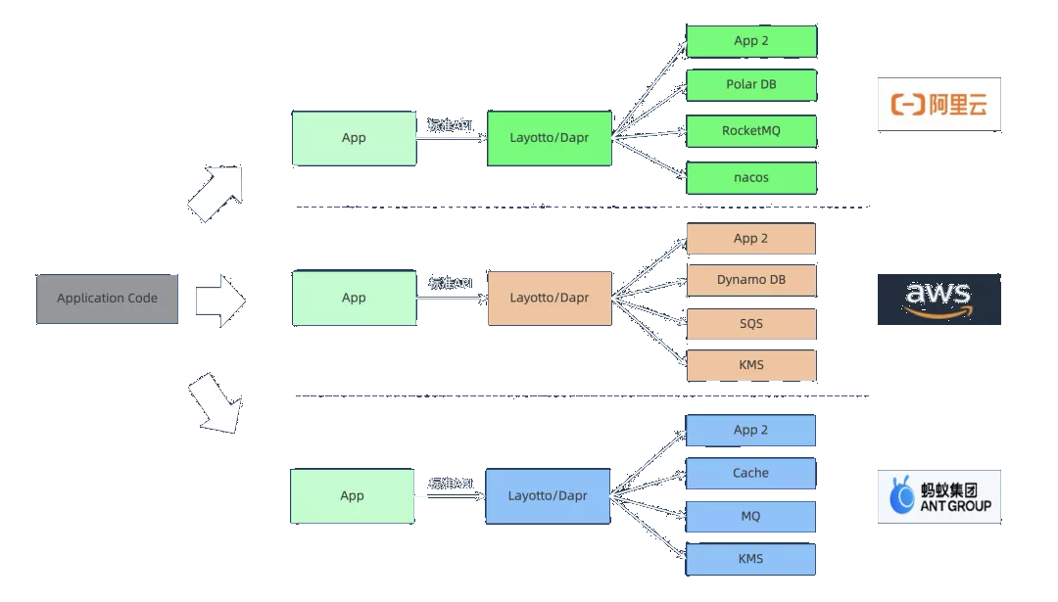
Standard API -- Key to Success
https://mp.weixin.qq.com/s/com0uv4PyslE8Id9sStybw

Slide 34
Drawbacks of Application Runtime
Development and Operation of Application Runtime is also difficult
Application Runtime API should be stable
It's impossible to change from one Application Runtime platform to another

Slide 35
Serverless
Serverless allocates machine resources on demand.
Serverless vendors offer compute runtimes, also known as Function as a Service (FaaS) platforms.

Slide 36
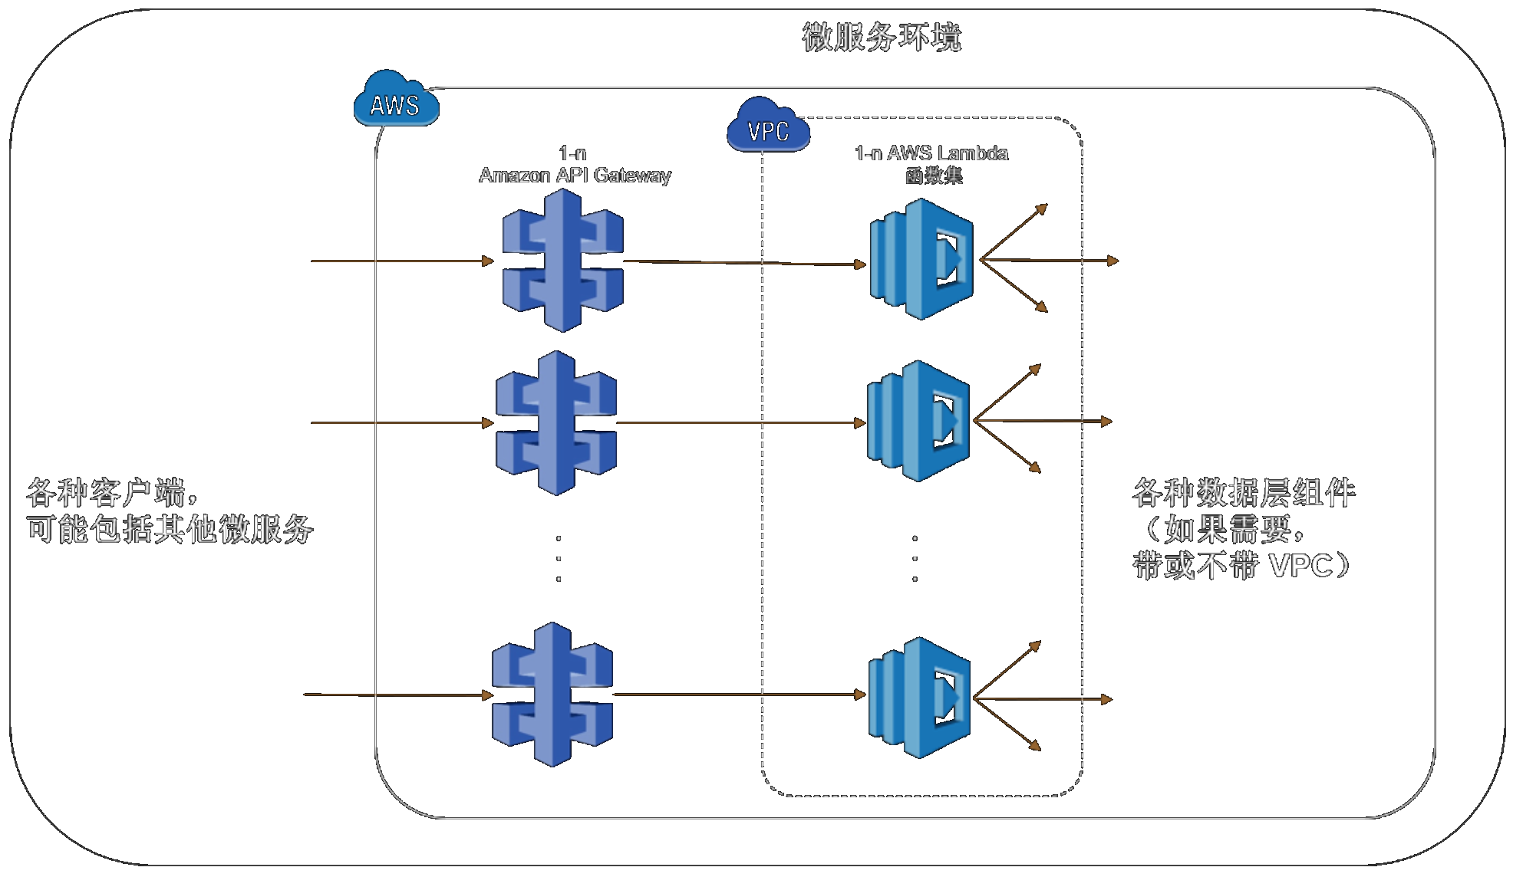
AWS Serverless Microservice
https://aws.amazon.com/cn/serverless/getting-started
http://d0.awsstatic.com/whitepapers/International/cn/AWS_Serverless_Multi-Tier_Architectures_CN
https://docs.aws.amazon.com/whitepapers/latest/microservices-on-aws/serverless-microservices.html

Slide 37
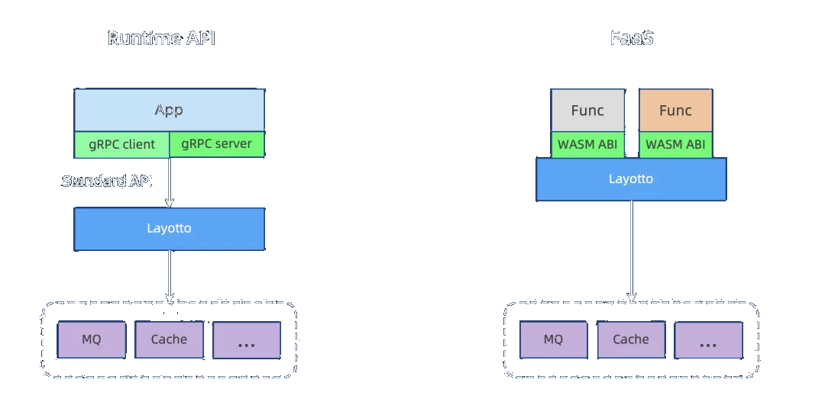
Serverless based on Application Runtime
https://mp.weixin.qq.com/s/com0uv4PyslE8Id9sStybw

Slide 38
Cloud service & Cloud native
Iaas frees IT team
Paas frees Architecture team
Saas frees Development team
Cloud native technologies empower organizations to build and run scalable applications in modern, dynamic environments such as public, private, and hybrid clouds. Containers, service meshes, microservices, immutable infrastructure, and declarative APIs exemplify this approach.

Slide 39
What drives microservice revolution?
Technology requirement
Efficiency of organization

Slide 40
What drives microservice revolution?
Technology requirement
reduce the difficulty of developing microservice
reduce the difficulty of operating microservice
not being restricted by cloud venders
Efficiency of organization
provide more generic ablities
maintain less components with same abilities
reduce cost

Slide 42
What's the future of microservice?
Application
Generic standard API
Opensource components will default support
Business Architeture become important and popular
Infrastructure
Much higher performance
Mesh/Application-Runtime Standard vs Vendor custom Implement
Cloud-native full microservice technology stack
serverless microservice

Slide 43
Standard/API is more important
TCP/IP Protocol
Mysql Syntax
Redis API
Protocol Buffer / gRPC
Kubernetes API
Application Runtime API

Slide 44
Join the future of microservice
Join the opensource
Try mesh or application runtime

Slide 45
Reference
https://microservices.io
https://martinfowler.com/articles/microservices.html
https://nginx.com/blog/what-is-a-service-mesh/
https://istio.io/latest/about/service-mesh/
https://mp.weixin.qq.com/s/G8vmlJyaimux_K-548kFbA
https://docs.dapr.io/concepts/overview/
https://isovalent.com/blog/post/2021-12-08-ebpf-servicemesh
https://github.com/mosn/layotto
https://mp.weixin.qq.com/s/com0uv4PyslE8Id9sStybw
https://aws.amazon.com/cn/serverless/getting-started
http://d0.awsstatic.com/whitepapers/International/cn/AWS_Serverless_Multi-Tier_Architectures_CN
https://docs.aws.amazon.com/whitepapers/latest/microservices-on-aws/serverless-microservices.html
https://github.com/wongoo/dapr-demo

Slide 46

Q&A

